Slide 1
RISC-V Security January 2022

Slide 2
Intrinsic Security
RISC-V
Process
Standards Compliance, Security Incidence Response
Security Ecosystem
Firmware,
Software, and
Tools
Clean Slate architecture – learn the lessons of the past
Security as a basic feature of hardware, firmware, software
Royalty Free – democratising innovation
Root-of-Trust, Secure Boot
Confidential Computing
Hardware
Security
Capabilities
Trusted Execution Environment
Memory Safety
Crypto Accelleration
Control Flow Integrity
Side Channel Leakage Protection
Embedded
Application
Server
Processor Cores

Slide 3

Competition (Work-in-Progress)
Feature |  | arm | intel | AMD
Comprehensive Ecosystem | SBI definition, OPEN SBI, Keystone TEE Framework | Standard Security APIs Open Firmware Reference Implementations Security Model | Standard Security APIs Reference Implementations | Standard Security APIs Reference Implementations
Trusted Execution Environment | PMP based TEE, Hypervisor support, S-Mode MPU (no isolation at m-mode) | Trustzone A/M class HW TEE | Intel TXT, Intel VT-x | AMD SVM
Confidential Compute |  | v9A Realms - Confidential Compute Architecture | Intel TDX – Confidential VM Architecture Intel SGX – Confidential Applications Architecture | AMD SEV (-ES, -SNP) - Confidential VM Arch.
Arbitrary Privileged Code Execution | ePMP, NX/SMAP/SMEP | Privilege Access Never | NX/SMAP/SMEP | XD/SMAP/SMEP
Control Flow Integrity |  | Branch Target Identifier Pointer Authentication Code | Indirect Branch Tracking Shadow Stack | Shadow Stack
Memory Safety | ePMP | Memory Tagging Extension
Side Channel Leakage |  | Speculation Barriers | Speculation Barriers | Speculation Barriers
Cryptography | AES, SHA2, SM3, SM4, entropy, Data Independent Execution Latency | AES, SHA2, SHA3, SM3, SM4, RNG, Vector | AES, SHA, RNG, AVX-512 | AES, SHA, RNG, AVX2
Crypto library |  | AArch64cryptolib | Intel IPP Cryptography | AMD Optimizing CPU Libraries

Slide 4
RISC-V Security 5 year horizon
Platform Security Model outlining RISC-V security capacities and system’s integration
Tools and Software support for RISC-V security capabilities
Protection against side-channel information leakage at the hardware level
Robustness capabilities to prevent malicious manipulation of e.g., code execution flows
Cryptography support for small to large devices, including Post-Quantum Crypto
Memory isolation and Trusted Execution Environments to securely separate applications from each other
Support for Confidential Compute models to enhance application and data privacy
Blockchain technology on RISC-V based systems

Slide 5
Long-Term Priorities
Security Incident Response Team (SIRT) maintenance
Platform Security Model creation
Platform Security Model and RVI Platforms integration
Security functionality competitive / gap analysis
Enhanced cryptography functionality
Microarchitectural side channel leakage mitigations and Control Flow Integrity capabilities
Enhanced memory security model
Define RISC-V architecture for TEEs and Confidential Computing
Security (software) ecosystem enablement
Capability-based solution(s)

Slide 6
Roadmap (Work-in-Progress)
Security Model
Ecosystem, Reference implementations, etc.
Application-TEE, Confidential Compute, and Capabilities-Based (AP-TEE)
AP-TEE TG + Cap-based TG (?)
Lightweight TEE
Pointer Masking (J extension)
Memory Tagging
Control Flow Integrity (CFI)
CFI TG(s)
Blockchain whitepaper
International Scalar Crypto
Scalar Crypto
Vector Crypto
PQC Crypto
IOMMU within Software HC
IOMMU
S-mode MPU
ePMP
IOPMP
Microarchitectural Side Channel (uSC) leakage mitigations
uSC TG(s): Temporal Fencing and others (?)
2021
2022
2023
SIG work
TG work
HC work

Slide 7
Backup

Slide 8
RISC-V Security Rationale
Clean-slate architecture invites new hardware security solutions
Open security model accelerates hardware security innovation
Opportunity to incorporate security industry learnings & best practices
Open governance facilitates collaboration on best security approach
Royalty free model enables new open-source hardware security solutions

Slide 9
Security and RISC-V
RISC-V’s open and clean-slate design presents a unique opportunity to re-think security for the next generation of compute infrastructures.
Become foundation for an Intrinsic Security model
Create robustness against malicious code, bugs, exploits
Enabling Trusted Execution and Confidential Computing – with Zero Trust
Secure App
Secure App
App
App
App
Secure System SW + Runtimes
Trusted OS
Rich OS
Secure Hardware Baseline
Trusted Execution Environment Confidential Computing
Crypto Acceleration
Memory isolation, Control Flow Integrity, Side Channel Protection
Hardware Root of Trust, Secure Boot

Slide 10
2021 Highlights
New Chair and Vice-Chair (mid-year)
enhanced-PMP specification ratified
Crypto Scalar specification ratified
SIRT process defined
Draft S-mode MPU specification
New SIGs: Blockchain, CFI, and uArchitectural Side Channel
Refocused & renamed Security Tech SIG to Trusted Computing SIG
IOMMU effort launched under Software HC

Slide 11
1st Half 2022 Targets
Competitive gap analysis & Roadmap
SIRT process integration & communication
Draft Platform Security Model
Blockchain SIG (draft) white paper
Control Flow Integrity SIG strategy recommendations
Trusted Computing SIG architecture recommendations
Microarchitectural Side Channel SIG strategy recommendations
Memory Safety SIG creation
Crypto Vector draft specification
International Crypto TG

Slide 12
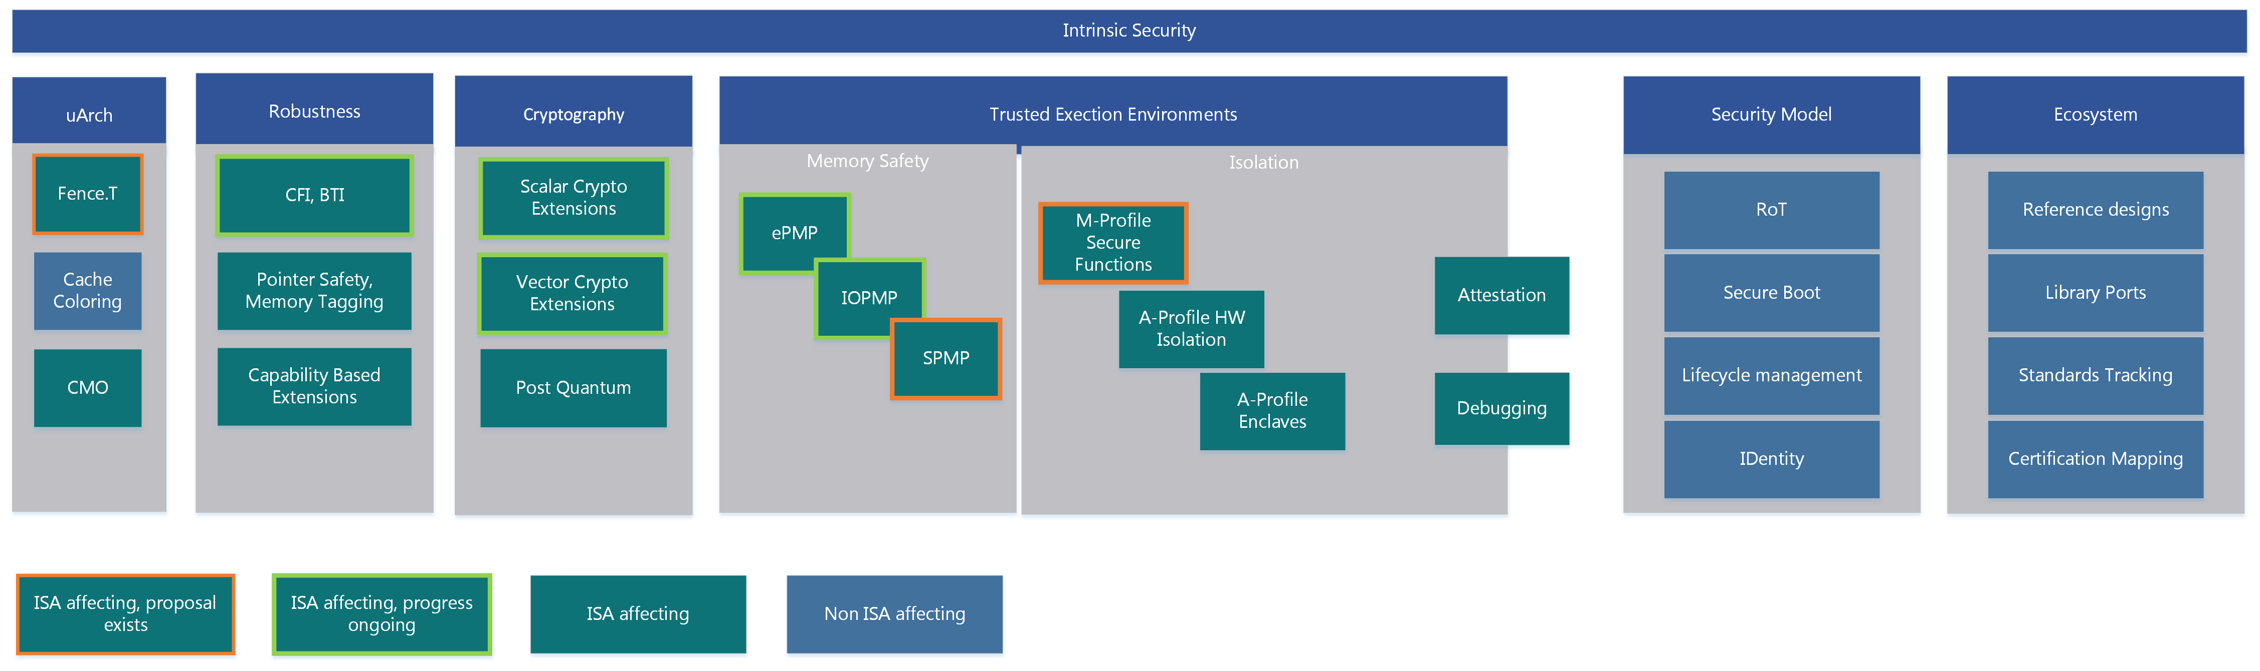

Slide 13
Competition (Work-in-Progress)
Feature |  | arm | intel | AMD
Comprehensive Ecosystem | SBI definition, OPEN SBI Keystone TEE Framework | Standard Security APIs Open Firmware Reference Implementations Security Model | Standard Security APIs Reference Implementations | Standard Security APIs Reference Implementations
Trusted Execution Environment | PMP based TEE, Hypervisor support, S-Mode MPU (no isolation at m-mode) | Trustzone A/M class HW TEE | Intel TXT, Intel VT-x | AMD SVM
Confidential Compute |  | v9A Realms - Confidential Compute Architecture | Intel TDX – Confidential VM Architecture Intel SGX – Confidential Applications Architecture | AMD SEV (-ES, -SNP) - Confidential VM Arch.
Arbitrary Privileged Code Execution | ePMP, NX/SMAP/SMEP | Privilege Access Never | NX/SMAP/SMEP | XD/SMAP/SMEP
Control Flow Integrity |  | Branch Target Identifier Pointer Authentication Code | Indirect Branch Tracking Shadow Stack | Shadow Stack
Memory Safety | ePMP | Memory Tagging Extension
Microarch. Side Channels |  | Speculation Barriers | Speculation Barriers | Speculation Barriers
Cryptography | AES, SHA2, SM3, SM4, entropy, Data Independent Execution Latency | AES, SHA2, SHA3, SM3, SM4, RNG, Vector | AES, SHA, RNG, AVX-512 | AES, SHA, RNG, AVX2
Crypto library |  | AArch64cryptolib | Intel IPP Cryptography | AMD Optimizing CPU Libraries
Trusted Computing SIG
Memory Safety SIG
CFI SIG
Memory Safety SIG
uArch Side Channel SIG
Crypto TG

